Slide 1





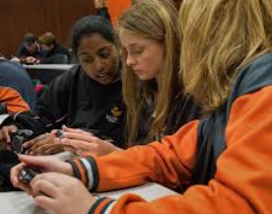

Our class Social contract
Positive Behaviour Support (PBS)
Following the BSC Positive Behaviours Matrix:
What do we want our classroom to look like this year?

Slide 2





our school pillars

Slide 3
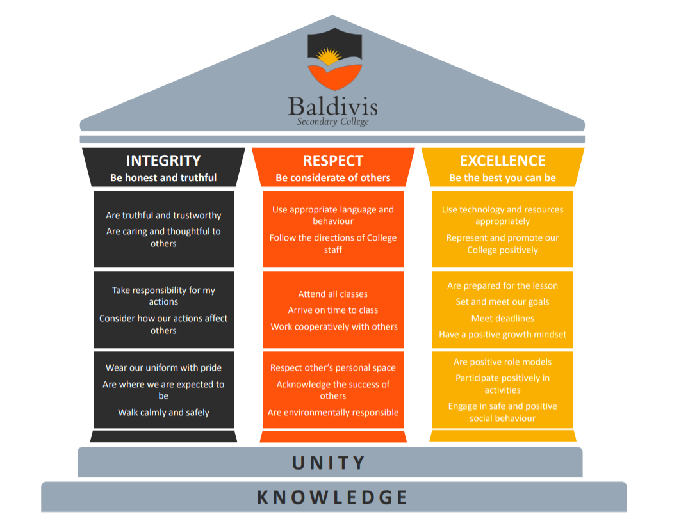



The matrix
As a class…
Read each section and discuss the points:
Integrity
Respect
Excellence
2. Write down 2-3 of the points that you want to focus on from each section

Slide 4
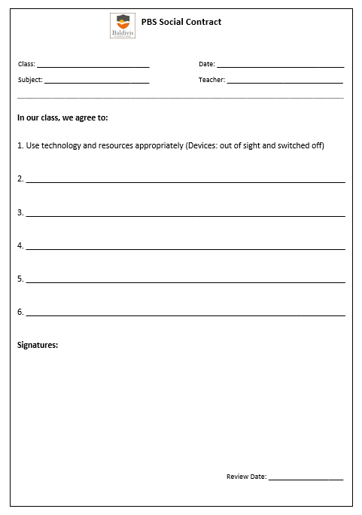

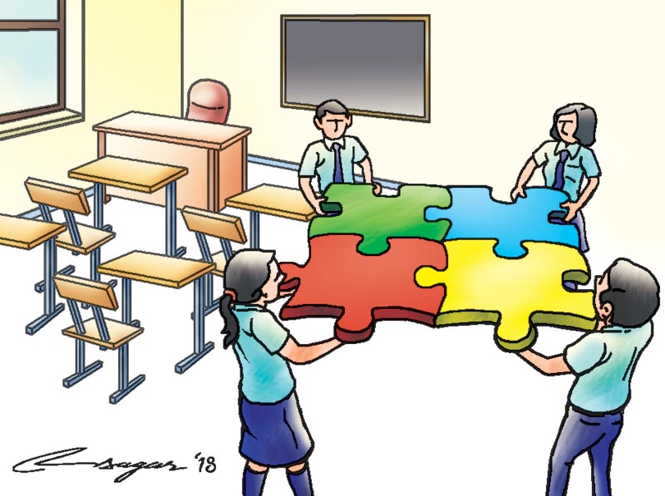
What is a social contract?
It is a class wide agreed set of norms for the class to follow.
It is the behaviours we want to see to create a safe and engaging space to learn.
Our non-negotiable:
Use technology and resources appropriately (Devices: out of sight and switched off)

Slide 5
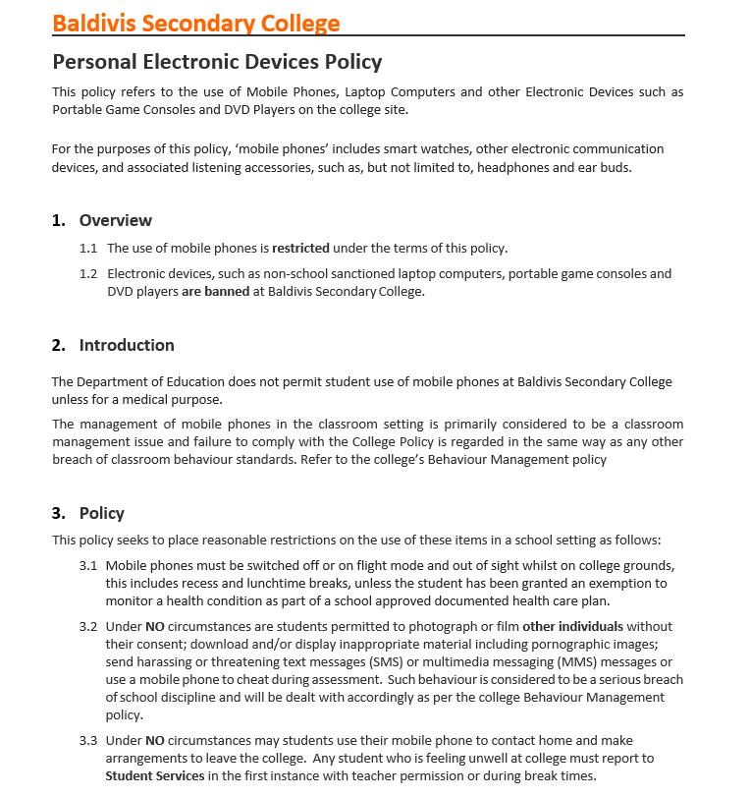
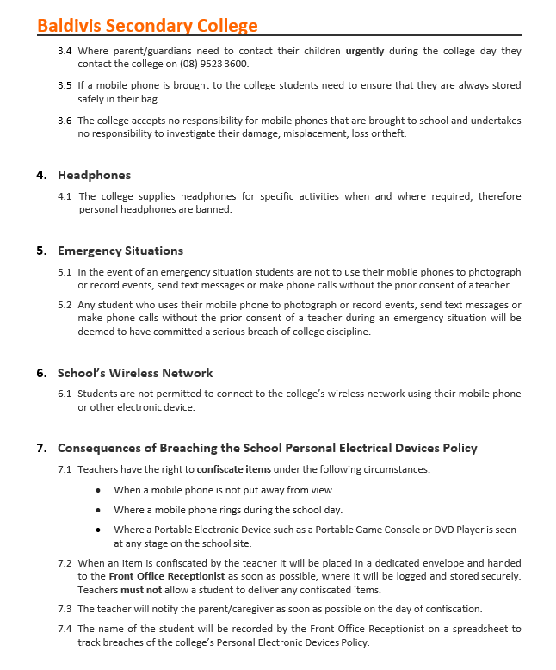
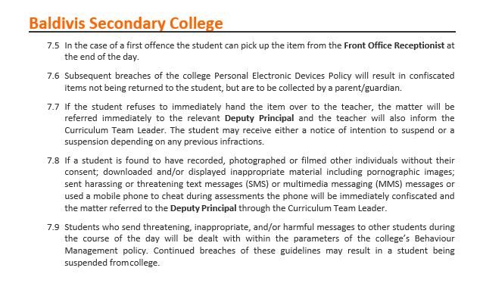

The Phone policy in WA Schools: Review & Discuss
Notes:
Add Policy

Slide 6
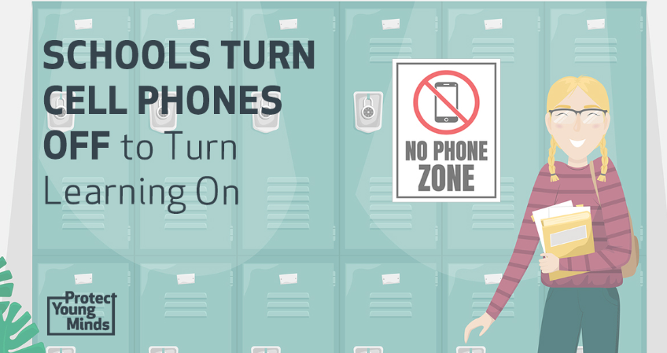



What does the phone policy mean?
Whole school policy -
We always use technology and resources appropriately (Devices: out of sight and switched off)
This means we:
Place earphones and devices safely away in our bags before we enter school grounds
Place bags at the front of the classroom (use pigeon holes if available)
Use school laptops and desktop computers for educational purposes – under direct teacher instruction
Keep all devices in our bags during transition between classes & during recess and lunch breaks
Will be rewarded for following the policy
Understand that consequences including confiscation of devices will result if devices are seen during the school day
Understand that urgent communication with parents / guardians is still available via the front office or Student Services during break times. And urgent messages from parents / guardians will be delivered to students by student ambassadors

Slide 7


social contract guidelines
Class wide: we develop ideas as a whole class – that means we all get a say.
Set of norms: behaviours that we decide are the standard and these become our non-negotiables.
Agreed: the class have to come to a consensus & an overall agreement.
Expectations: everyone in the class follows and abides by the contract, even me!
Use the Positive Behaviour Matrix to select the behaviours you would like to focus on at the start of the year.
We keep revisiting and updating our social contracts throughout the year.

Slide 8



social contract instructions
1. Divide into groups of 3-4 (follow teacher’s direction)
2. On the Positive Behaviours Matrix:
Highlight the behaviours you think are the most important and want to see in our class
3. From this list – decide on your top 5
4. Share with the class (write on whiteboard) and each group with explain their choices
5. Everyone will ‘tick’ their top 5 ideas from the selection on the board
6. The top 5 behaviours will become our class norms and the first edition of our social contract
Our social contract is written up and signed by all class members.

Slide 9
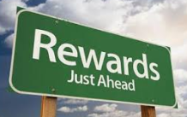


Recognition System
When you follow the Matrix criteria you will be rewarded.
Types of rewards:
VIVO Points They can be used to buy awesome prizes at the VIVO Shop
Positive Phones Calls / Emails home
Invitation to Reward Days
Commendation Awards
Merit Certificates
Classroom Prizes

